Slide 1

Regression Models are Used in Business
Presentation by:
Patil kruti

Slide 2

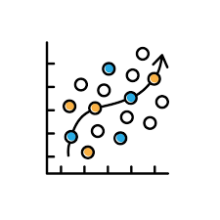

What is Regression?
Regression predicts numerical outcomes based on input variables.
Used for forecasting, optimization, and decision-making.

Slide 3

Types of Regression Models
o1.
Linear Regression
o2.
Multiple Regression
o3.
Polynomial Regression
o4.
Logistic Regression (classification but used in business)
o5.
Time-Series Regression

Slide 4

Why Businesses Use Regression
Forecast sales
Predict customer demand
Estimate pricing sensitivity
Identify key business drivers
Optimize marketing spend

Slide 5
Sales Forecasting
Regression helps predict future sales using:
Historical sales
Seasonality
Marketing spend
Competitor pricing

Slide 6
Customer Demand Prediction
Businesses estimate demand using regression to improve:
Inventory planning
Logistics
Production scheduling

Slide 7

Marketing ROI Analysis
Regression helps measure:
Impact of ad spend
Channel performance
ROI of campaigns

Slide 8
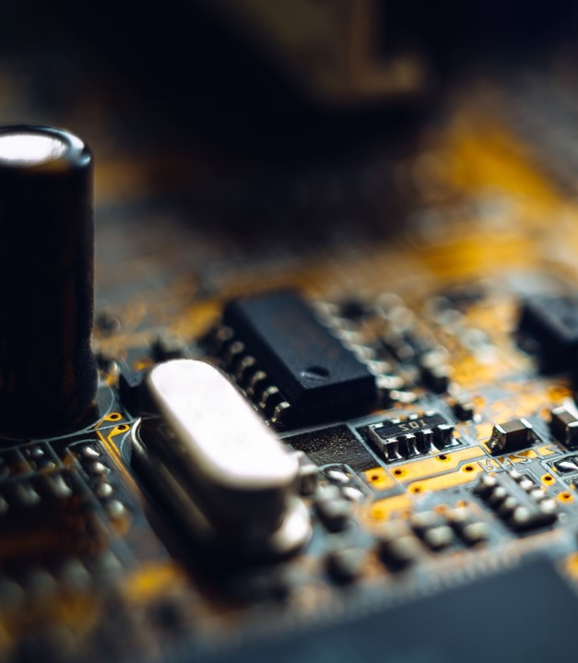
Pricing Strategy
Analyze how price changes affect demand
Identify optimal price points

Slide 9
Risk & Financial Forecasting
Used in:
Credit risk modeling
Revenue forecasting
Budget planning

Slide 10
Conclusion
Regression models support data-driven decision making, improve forecasting accuracy, and optimize business operations.

Slide 11

Thank you

